Slide 1
Bolid market

Slide 2
Why would you buy Bolid Market?
How does it work?
The competition.
Demo

Slide 3
What is the App about?
Buy/Sell your favourite car(s)
Stay updated with the latest/cheapest offers.
Manage easily your soon-to-be-sold cars.
Get the best deals while browsing the app.

Slide 4
How does it work?

Slide 5
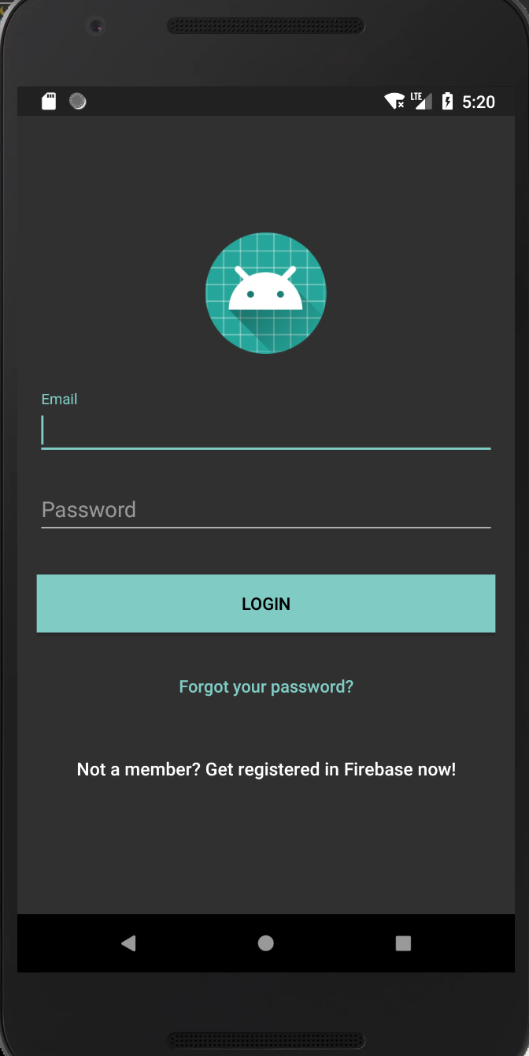
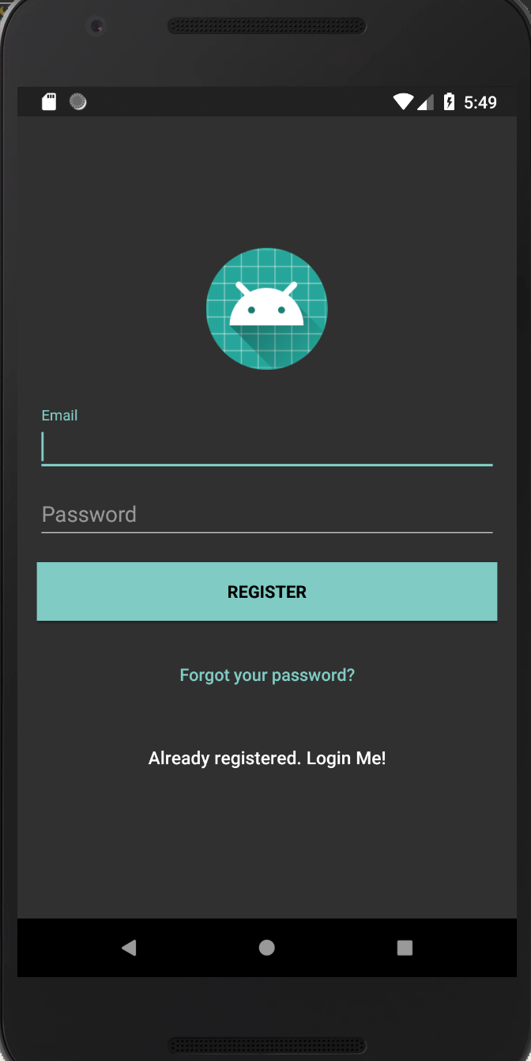
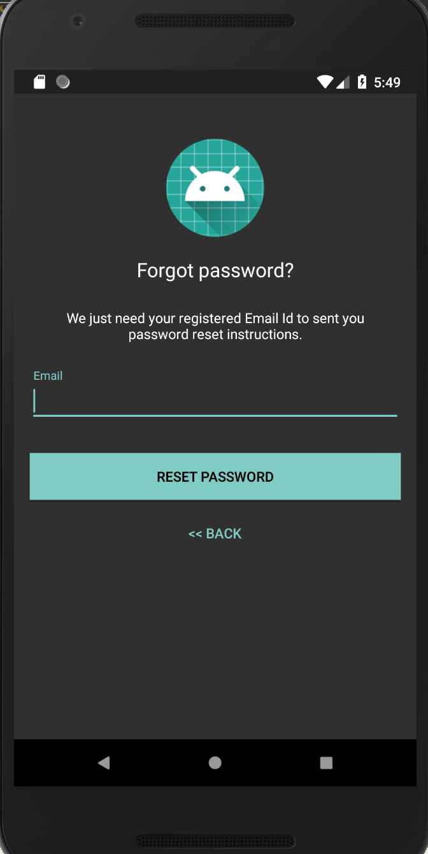

Slide 6
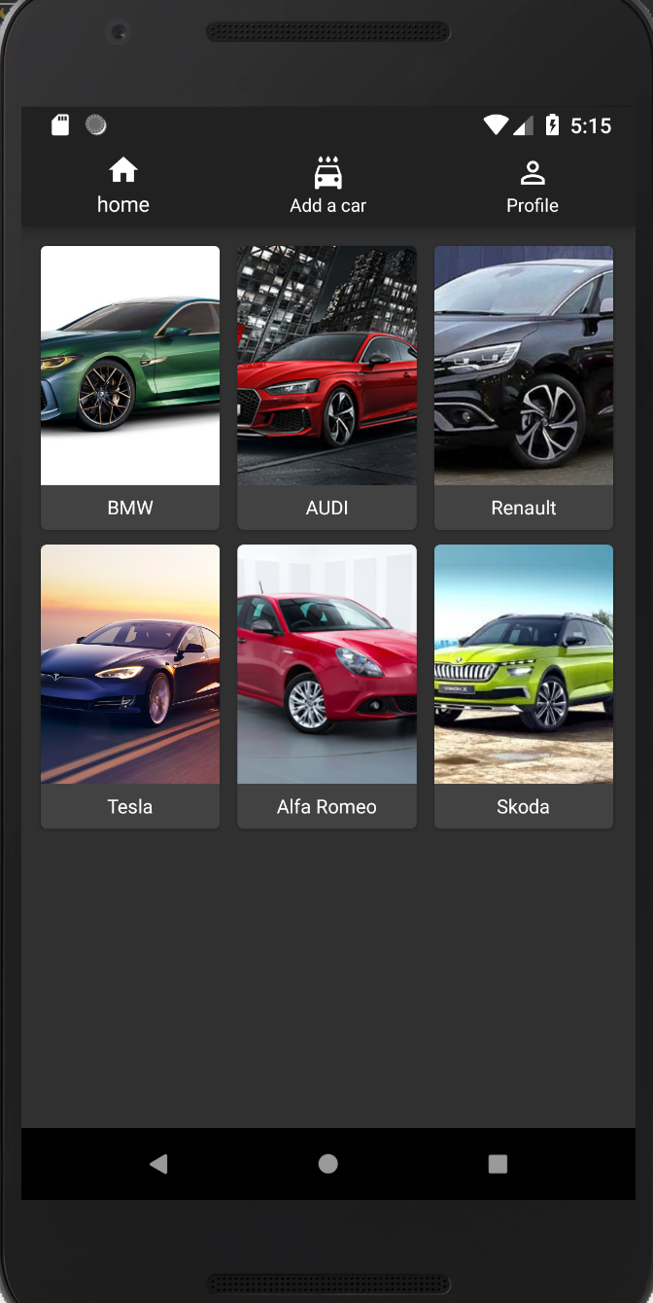
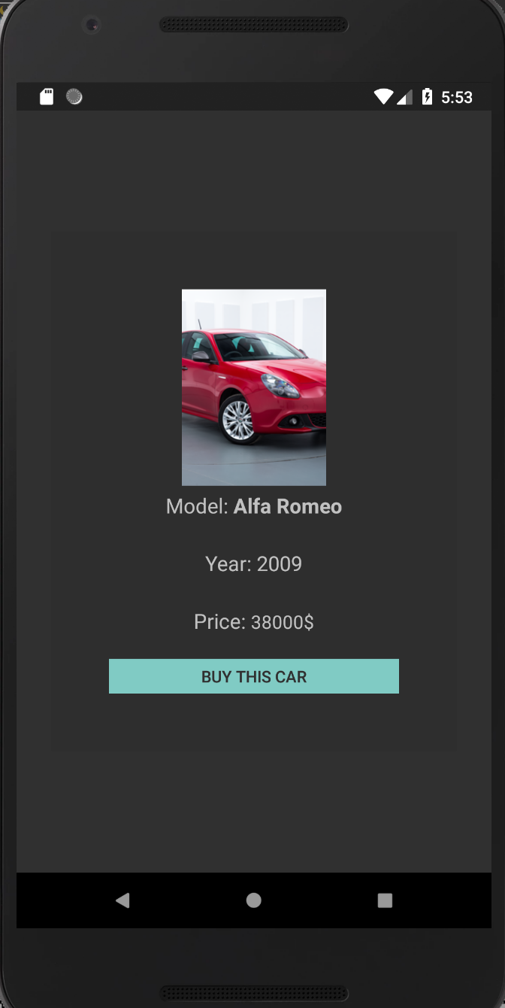

Slide 7
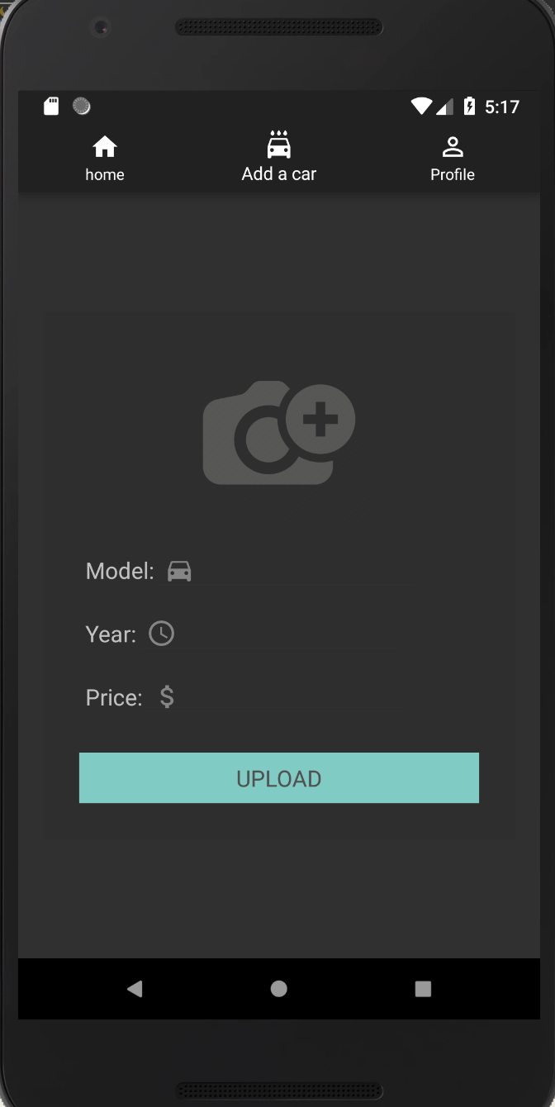
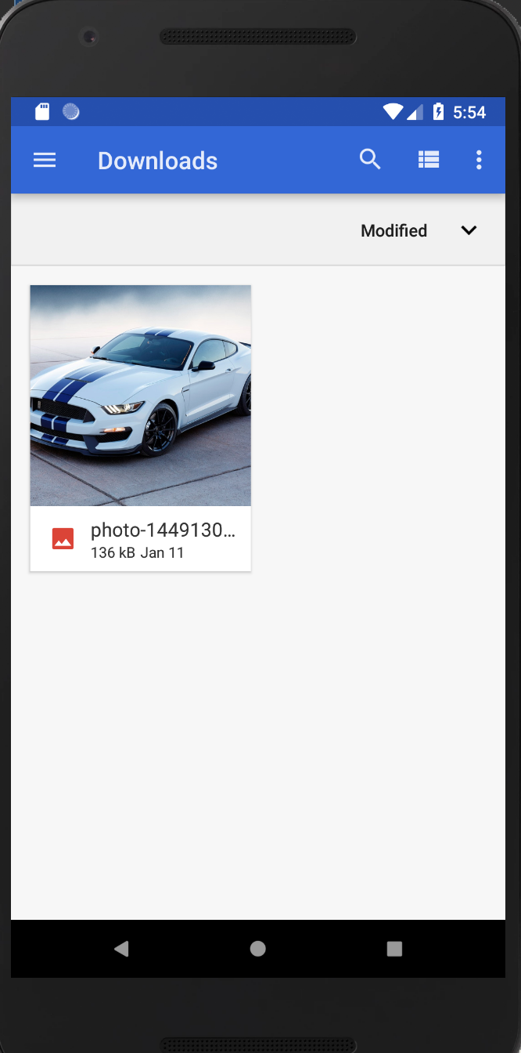
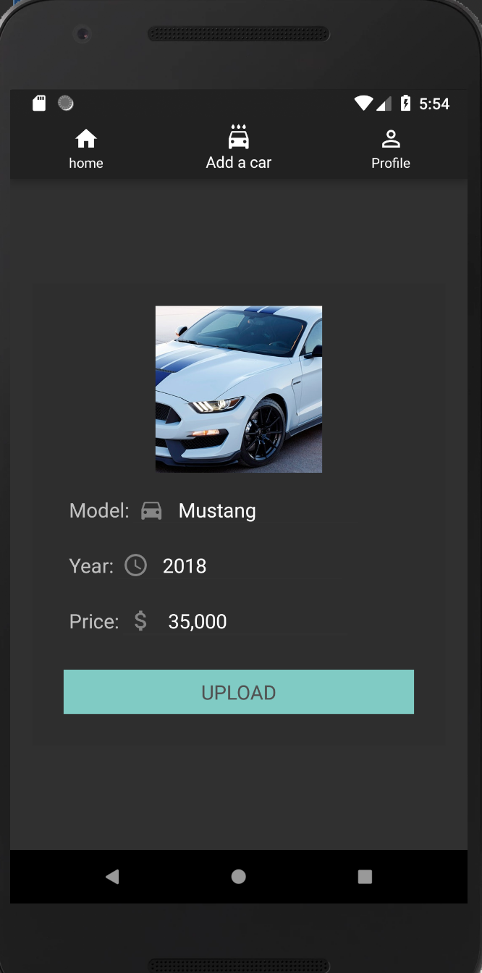

Slide 8
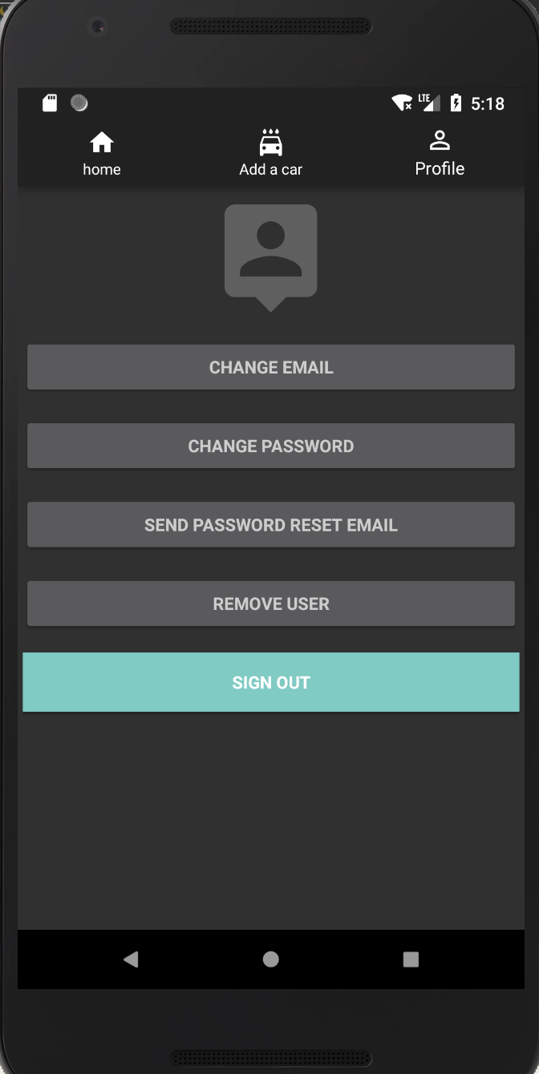
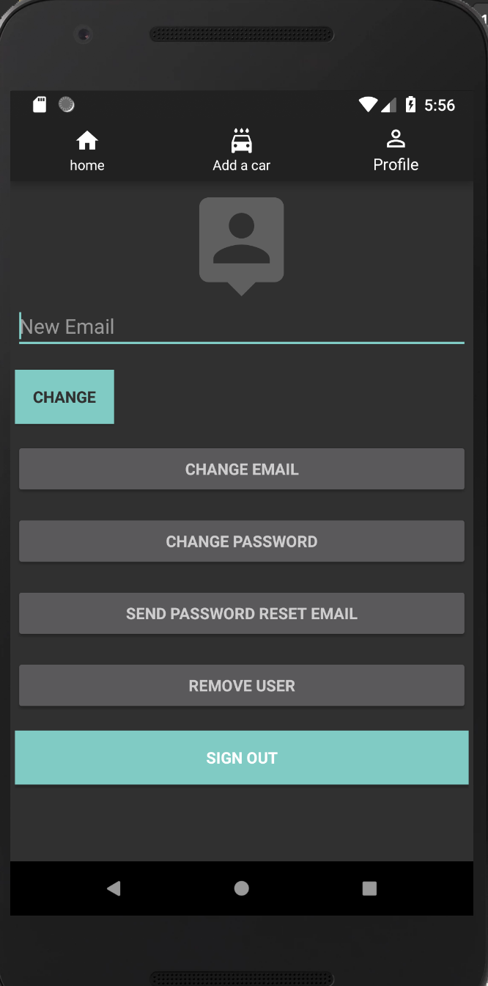

Slide 9
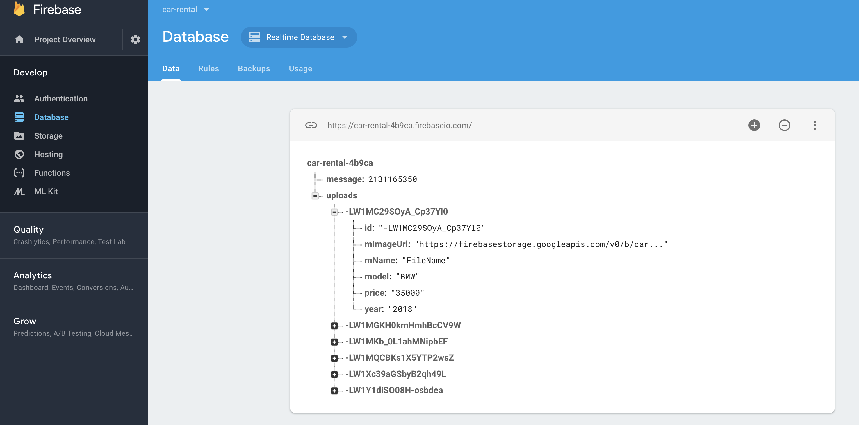

Slide 10
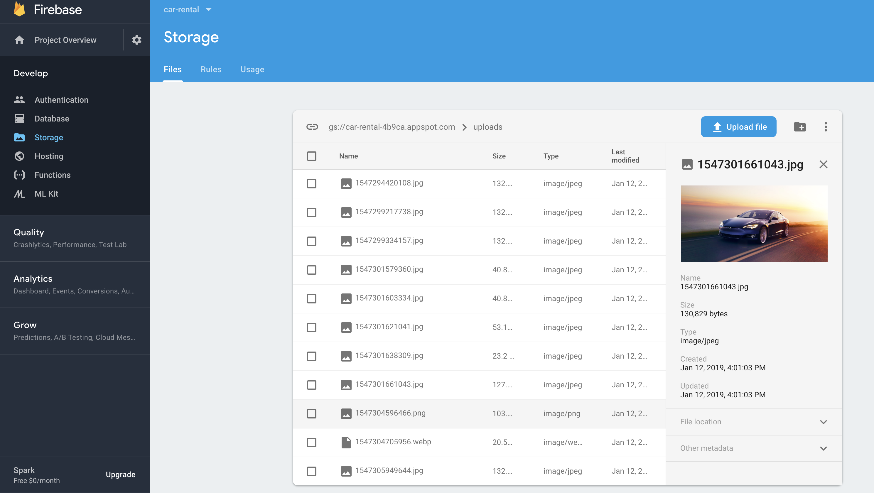

Slide 11
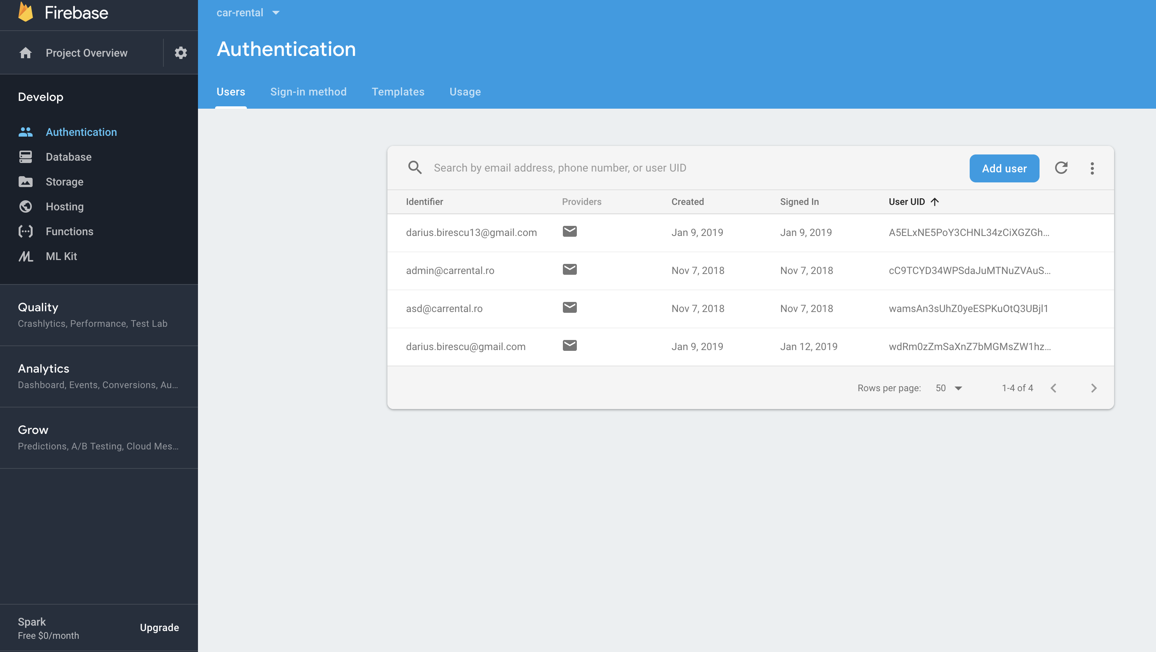

Slide 13
The competition
Mobile.de
Olx.ro
Autovit.ro
Lajumate.ro
Etc.

Slide 14
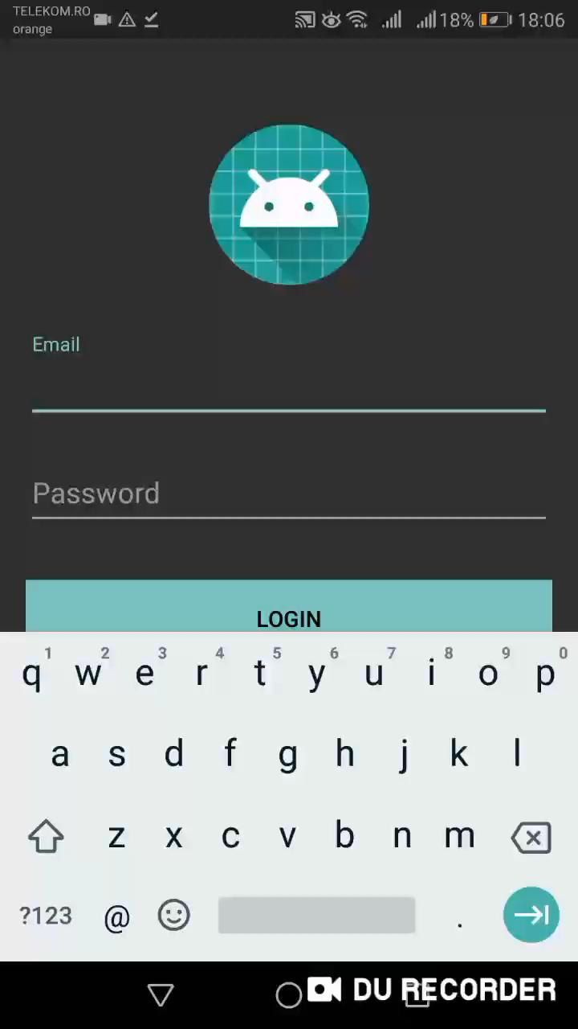
Demo time

Slide 15
Thank you

